Slide 1
Box Breaker Game Project
EE319H Introduction to Embedded System Honors
By Daniel Yang

Slide 2
Executive Summary
The game Box Breaker is played on a TI microcontroller interfaced with input and output hardware
The software implementation is done on Keil 5 IDE that includes sprite design, level design, and main file programming

Slide 3
The game is the final project of Introduction to Embedded System Honors (EE319H) that must fulfill the minimum requirements
Hardware Requirements | Two buttons Slide potentiometer with ADC Speaker with DAC Liquid crystal display (LCD)
Software Requirements | Two interrupt service routines (ISR) Three sprites Score display Two languages

Slide 4
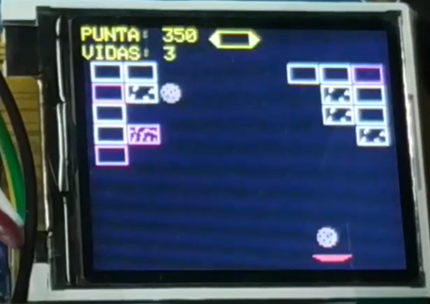
Box Breaker is like Brick Breaker, but instead of the ball hitting the brick, the cookie is hitting the box
English or Spanish
3 levels
4 lives
Each box can take 4 hit
Pink Box contains a powerup

Slide 5
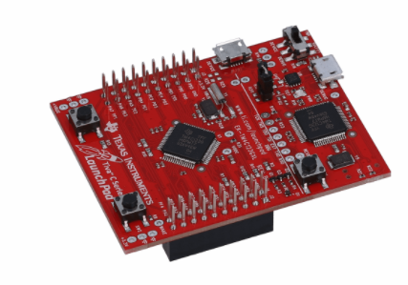
TM4C123GXL Microcontroller is the brain of hardware design
All Hardware components are connected to the board
The board receives the data from input hardware
The software then process that data
Finally, the data is sent to the output hardware

Slide 6
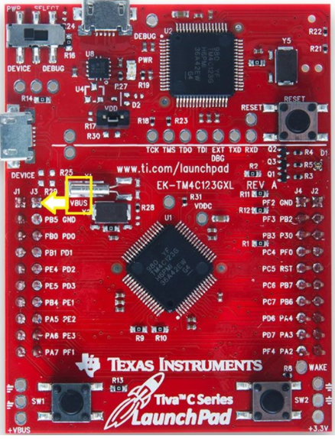


Two built-in buttons are used to change language and use power-up
PORT F4
Edge-triggered on the falling edge
PORT F0

Slide 7
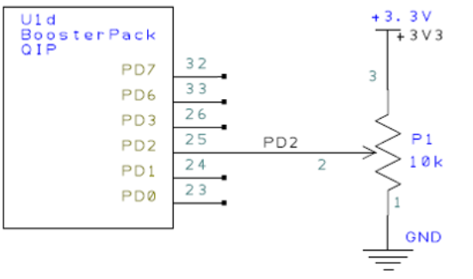
The slide potentiometer is an adjustable 10kΩ resistor that controls the paddle position
Microcontroller
d = 159 – 140 *n / 4095,
Where d is the position of the paddle
Value n from 0 to 4095
Built-in 12-bit ADC0

Slide 8
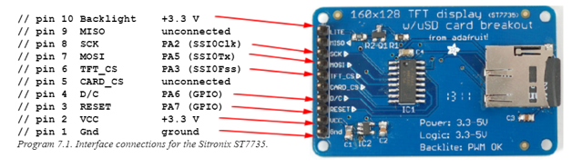
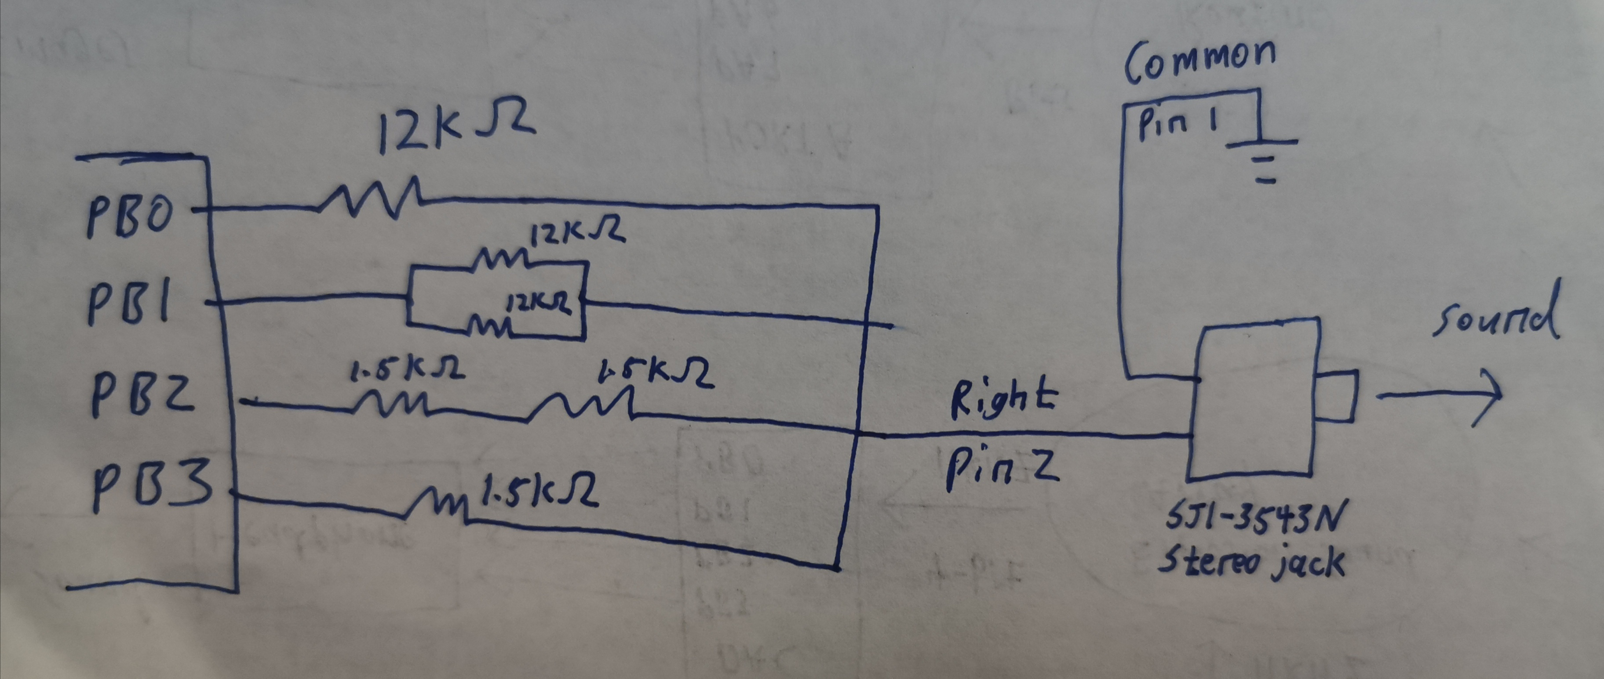
Two output devices are interfaced with the microcontroller, an LCD and a speaker
The 128x160 ST7745 LCD is used to display the game
The 4-bit binary-weighted DAC converts PB0-3 value to current for the speaker to play sound

Slide 9

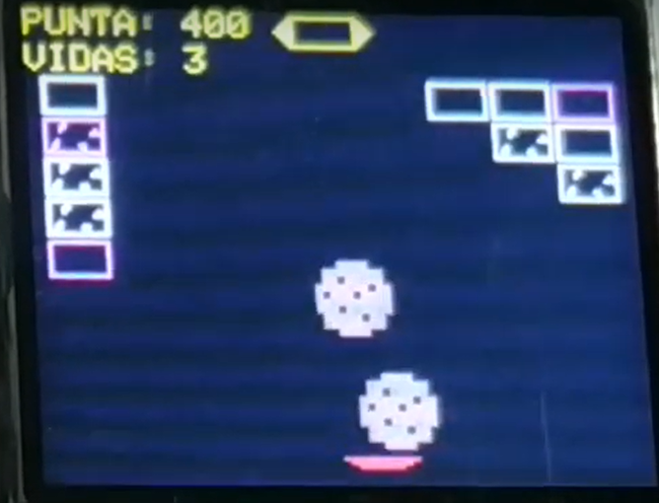




C++ Classes are written to code each sprite
Move
Draw
Power-up
Cookie Class
Lose-hp
Draw
Box Class
Move
Draw
Paddle Class

Slide 10
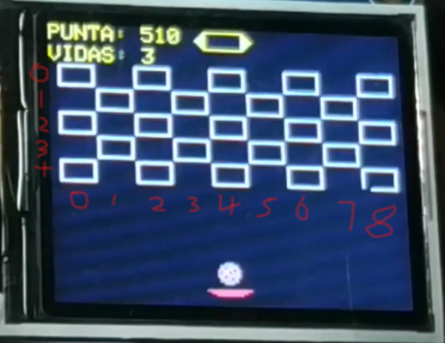
One function is written for each level to initialize a unique layout of boxes
Each Level can have a maximum of 5 rows and 9 columns of boxes
Box[5][9] 2D array is declared to represent each box sprite
The if statement check is used to initialize certain Box Objects
Uninitialized Box Objects will not become sprites
for (every row)
for (every col)
if (…)
initialize Box[row][col]

Slide 11
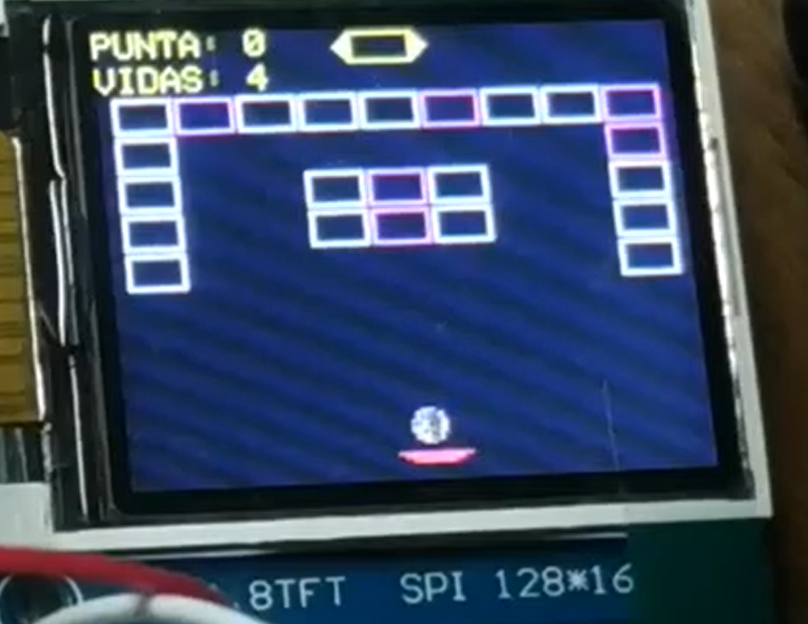
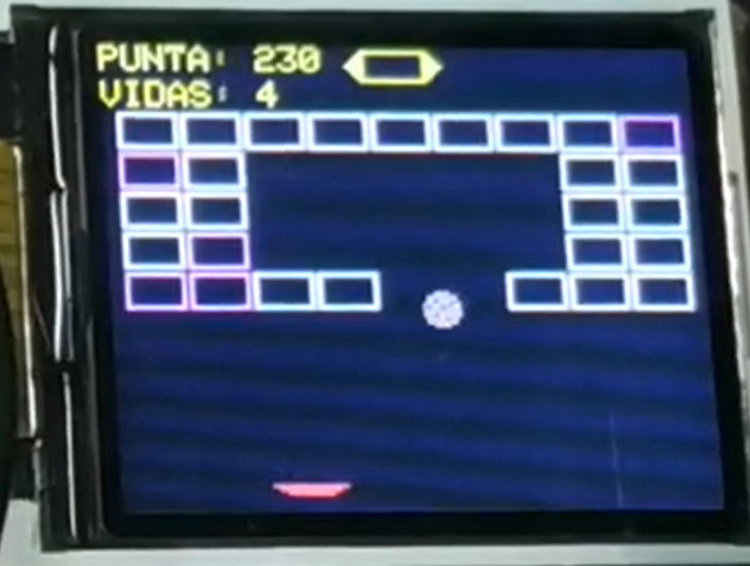
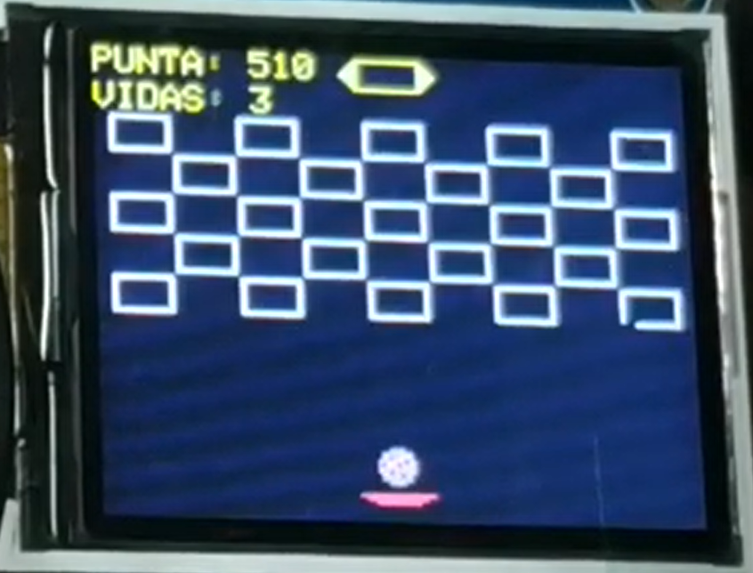
The design of each level

Slide 12
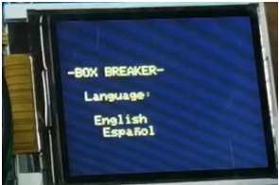
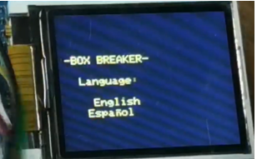
The game begins by prompting user to select a language
Change language output and language flag
PF4 pressed
Button
Initialization
Display title Screen
Game engine
PF0 pressed
None pressed
English is selected
Spanish is selected

Slide 13
Game Engine updates each sprite’s movement, collision, and display every cycle
Timer1A ISR
30 HZ
Main
Enable Game Engine
potentiometer
Call Paddle Object’s Move method
Initialization
moved
no
0
Semaphore
Call Cookie Object Move method
1
Call each Object’s Draw method
Initialize next level
Collision
Play “explosion” sound
yes
Semaphore = 0
no
Flip Cookie Object’s velocity variable
Box counter
> 0
0
Call Box Object’s loseHp method
Final Level
Win
Semaphore = 1
no
yes

Slide 14
Conclusion
I briefly explained the hardware interface with the microcontroller and software design
More levels and power-ups could be designed to make the game more interesting
A difficulty system could also be implemented

